Slide 1

Suppression of DARPP-32 Gene Expression Using Gold Nanoplex Decreases Drug Reward and Negative Effects of Withdrawal
Marie Severson
November 8, 2019

Slide 2
Introduction
Drug abuse and addiction is global health issue
Treatments available for acute and chronic abuse of opiates (Naloxone, Methadone)
No suitable treatment for psychostimulant abuse/ addiction
Notes:
According to the CDC, the number of drug overdose deaths in the US in 2017, was 70,237.

Slide 3
Introduction
Opiates, cocaine and amphetamines act on the dopaminergic system
DARPP-32 controls inhibition of protein phosphatase-1 (PP-1) and CREB/ERK, possibly reinforcing dependence on drugs of abuse
DARPP-32 is upregulated by drugs of abuse
DARPP-32 is found in all neurons receiving dopaminergic input
DARPP-32: dopamine and cyclic 3’, 5’ adenosine monophosphate regulated phosphoprotein
Notes:
Opiates, cocaine and amphetamines act on the dopaminergic system, which plays an important role in drug reward and addiction.
DARPP-32 -dopamine and cyclic 3’, 5’ adenosine monophosphate regulated phosphoprotein
PP-1- protein phosphatase-1- mediates neuronal signaling, regulates receptors, synthesizes proteins
cAMP- cyclic adenosine monophosphate
CREB- cAMP response element binding protein- transcription factor
ERK-1- extracellular receptor kinase- regulates transcription factors- when ERK is blocked, reinforcing effects of drugs are not present

Slide 4
Bonoiu, A. C., et. al, 2009
Nanotechnology Approach for Drug Addiction Therapy: Gene Silencing Using Delivery of Gold Nanorod-siRNA Nanoplex in Dopaminergic Neurons
Notes:
Conducted in vitro studies, transfecting dopaminergic neuronal cells with GNR-si-RNA and used dark field and confocal imaging to visualize uptake of nanoplexes into DAN cells. Q-PCR and western blot to measure DARPP-32 expression.

Slide 5
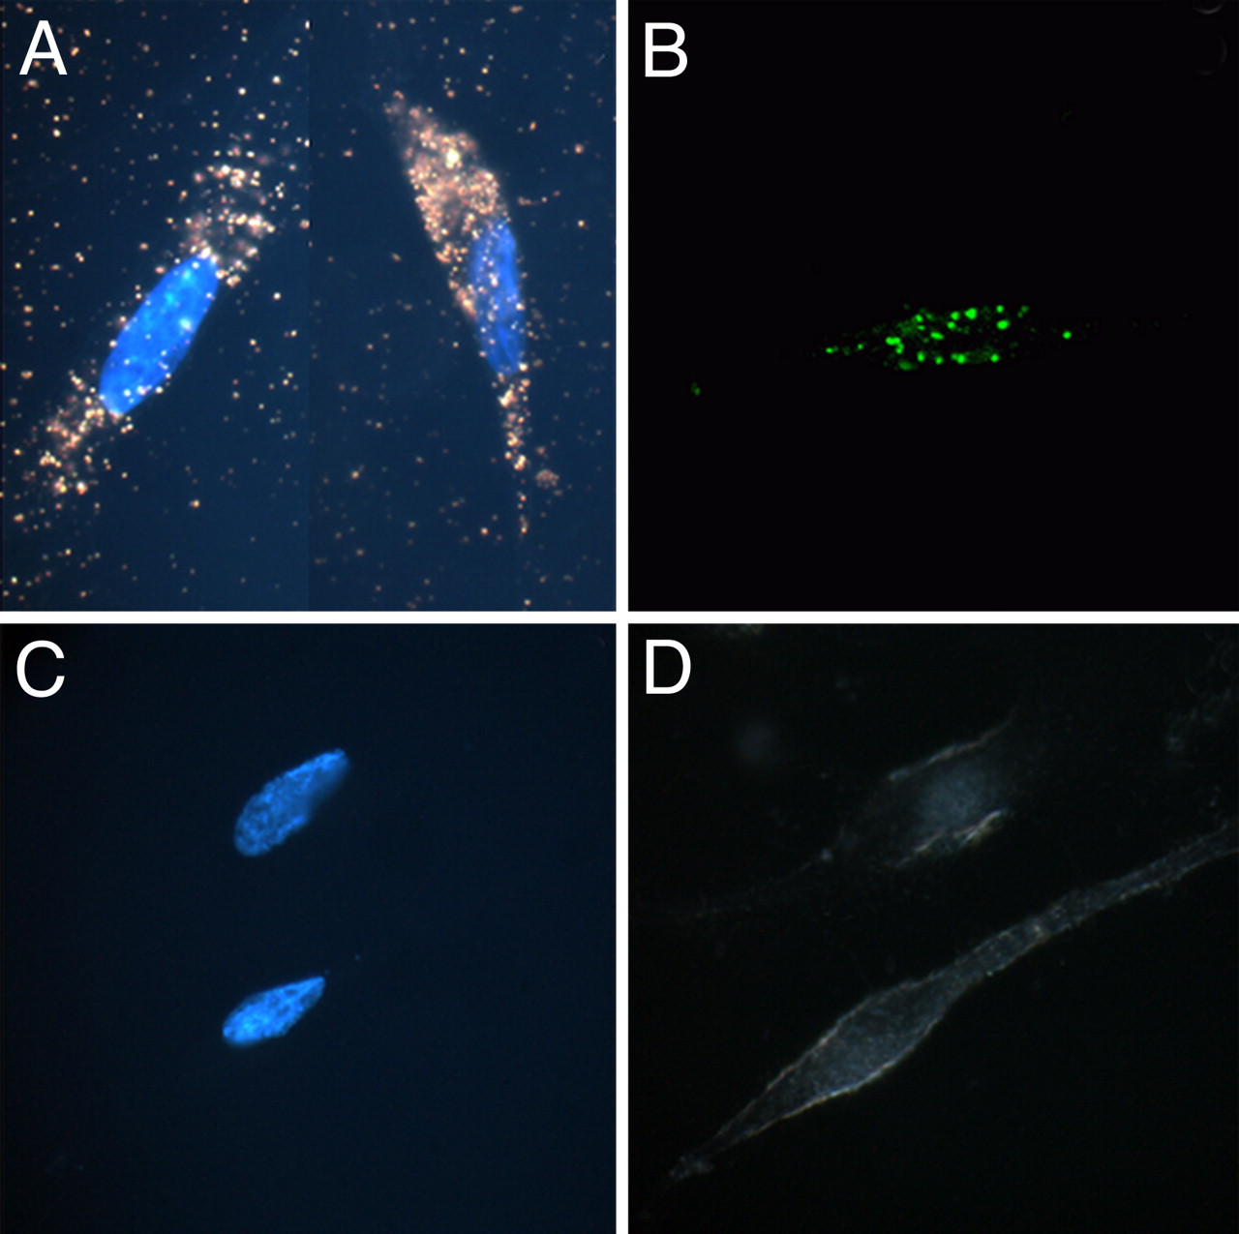
Fig 1
Hoechst
Confocal
GNR-siRNA
Free siRNA
Notes:
Robust uptake of nanoplex into DAN cells as opposed to the free siRNA- GNR facilitates uptake of siRNA
Fig. 1 shows the dark-field images of DAN cells, without (1c) and with (1a) treatment with the GNR-siRNA nanoplex. The cellular uptake of the nanoplexes can be easily observed from the strong orange-red scattering of the nanoplex treated, as opposed to the untreated, DAN cells. This experiment highlights another advantage of using nanotechnology in the delivery of therapeutics, where in addition to the therapeutic efficacy, the unique properties of the GNRs can be used to determine their uptake in cells using dark-field imaging. Confocal microscopy was also used to confirm the cellular entry of the nanoplexes in DAN cells, using GNR-siRNAF nanoplex. The confocal images of DAN cells treated with eithersiRNAF alone (Fig. 1d), or with GNR-siRNAF nanoplex (Fig.1b), demonstrate strong fluorescence signal from the treated, as opposed to untreated, DAN cells.

Slide 6

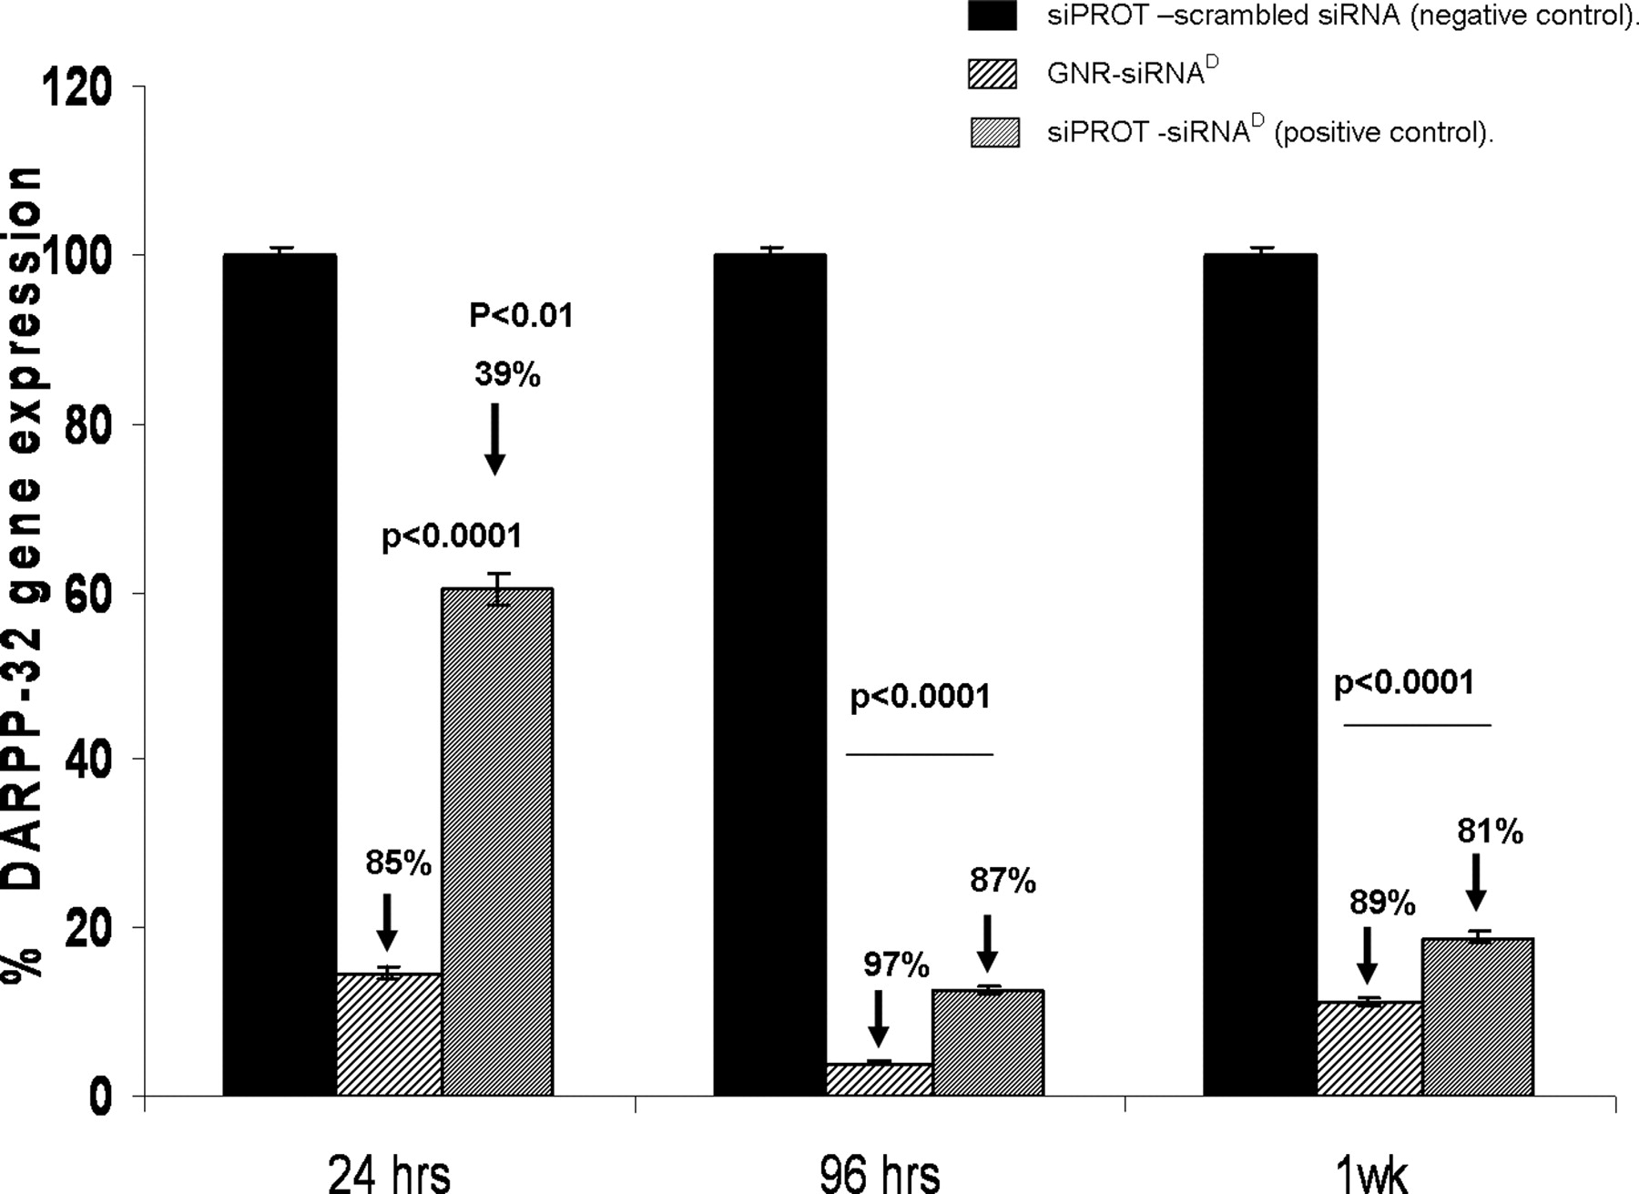
Fig 2
DARPP-32 expression is significantly decreased with GNR-siRNA treatment compared to siPORT-siRNA
Silencing efficiency
Notes:
Typo on slide- siPORT. siPORT is a commercially available transfection agent. Significant DARPP-32 suppression 1 week post transfection, but maximum suppression at 96 hr post transfection.
DAN cells were incubated with the GNR-siRNA nanoplexes and the efficiency of gene silencing was determined by measuring the percentage inhibition of the expression of DARPP-32 using quantitative real-time (Q)-PCR and Western blot. Results from these experiments show that significant inhibition (80%) ofDARPP-32 expression was produced in the DAN cells (Fig. 2) and this knockdown was observed up to 1 week posttransfection.

Slide 7
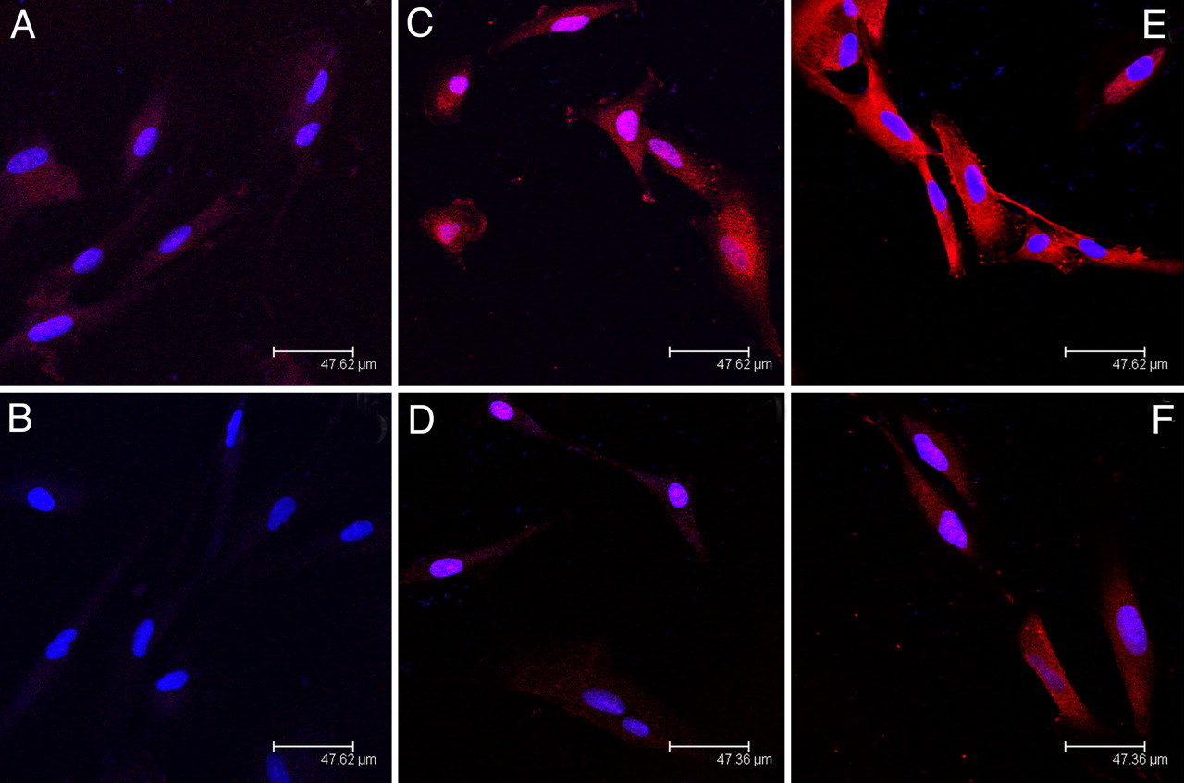
Fig 5
A-D: DARPP-32
E & F: ERK-1
Untreated Control
Morphine
Morphine
Nanoplex
Morphine/ Nanoplex
Morphine/ Nanoplex
Notes:
Alexa Fluor 647- red (DARPP-32 or ERK-1), DAPI- blue (DAN cell nuclei)
A- increased DARPP-32 expression in morphine-treated, non transfected DAN cells compared to C- untreated control
B- DARPP-32 with GNR-si-RNA- reduction of DARPP-32
D- Morphine treated DAN cells with nanoplex- reduction of DARPP-32 levels to background signal
E- Morphine treated un-transfected enhanced DARPP-32 levels
F- GNR-si-RNA transfected ERK cells- reduced DARPP-32
Using immunofluorescent staining, we also investigated the effect of the stimulator morphine (drug of abuse), and the antagonist GNR-siRNAD nanoplex, on the expression of DARPP-32 and the downstream effector protein ERK-1 in DAN cells. We found that in the morphine-treated DAN cells, the expression of DARPP-32 is enhanced when compared to the untreated control (Fig. 5 a and c, respectively). Subsequent treatment of the morphine-treated DAN cells with GNRsiRNA nanoplexes resulted in a reduction of the DARPP-32 levels to background signal (Fig. 5d). A similar reduction of ERK was also observed in the morphine-treated DAN cells following treatment with GNR-siRNAD nanoplexes (Fig. 5 e and f, respectively). These results indicate that morphine treatment enhances the DARPP-32 levels in the DAN cells and GNR mediated transfection of siRNAD reduces not only the levels of DARPP-32 expression, but also the expression of its downstream effector molecule ERK-1.

Slide 8
Fig 4
Notes:
PP-1 is decreased

Slide 9
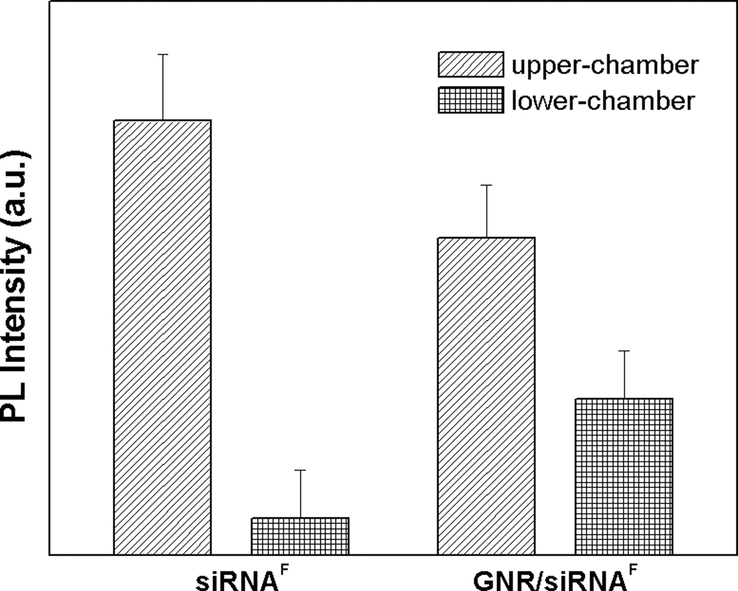
Fig 6
Upper chamber- blood end
Lower chamber- brain end
Notes:
Transmigration of GNR complexed to-siRNA is significantly higher than that of free siRNA via fluorescence signal distribution, photoluminescence.
Our results show that 4 h after incubation of GNRsiRNA in the upper chamber (blood side) of the BBB model, nearly 40% of the original fluorescence can be recovered in the lower chamber (brain side) of the model. Using similar conditions with free siRNAF, only 1% of the original fluorescence was recovered in the lower chamber (Fig. 6).

Slide 10
Conclusions
GNR-siRNA nanoplexes effectively silence DARPP-32, ERK, PP-1
GNR-siRNA is more efficient at silencing DARPP-32 and crossing the blood brain barrier than commercially available transfection agent
Safe- no cytotoxicity (as per MTT assay)
Notes:
Gold nanorod

Slide 11
Zachariou, V., et.al., 2002
Reduction of Cocaine Place Preference in Mice Lacking the Protein Phosphatase 1 Inhibitors DARPP-32 or Inhibitor 1
Notes:
Used knockout mouse model and CPP white walls and white floor, mesh floor and striped walls.
Day 1- habituation to smooth white cage, d2 allowed to explore both cages to determine preference. D3-d8 drug injections and confined to the less preferred side. Group 2 given saline and confined to preferred side (15 min). Measured locomotor activity using infrared beams. D9 allowed to explore both sides again. Compared time spent in drug paired side with time spent in that compartment before conditioning.

Slide 12

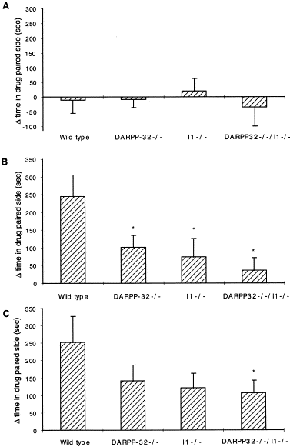



Saline
Fig 1
5mg/kg Cocaine
20mg/kg Cocaine
Notes:
Did not completely eliminate reward of cocaine

Slide 13
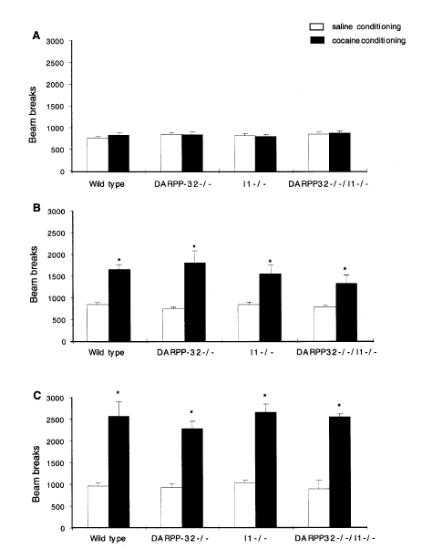
Fig 2
Saline
5mg/kg Cocaine
20mg/kg Cocaine
Notes:
Cocaine induced locomotor activity. Measured during saline and cocaine conditioning in wild type and DARPP-32 knockout. Ave number of beam breaks over 3 days. There was no difference in baseline locomotor response to saline. None of the mutations affected basal locomotor activity.No difference between WT and DARPP-32 cocaine tx.

Slide 14
Conclusion
Mice lacking DARPP-32 have a reduction in conditioned place preference to cocaine without changes in locomotor activity
Inhibition of DARPP-32 increased PP-1 function, which decreased the rewarding properties of cocaine

Slide 15
Ignatowski, T. A., et. al., 2015
Nanotherapeutic Approach for Opiate Addiction Using DARPP-32 Gene Silencing in an Animal Model of Opiate Addiction

Slide 16
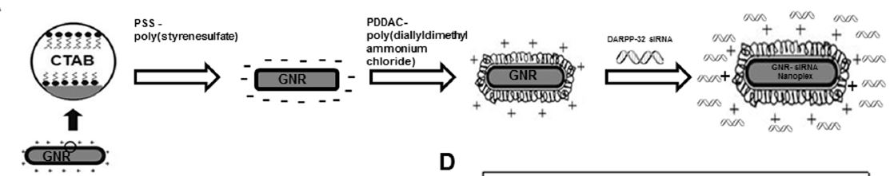
Fig 2A
Formation of Nanoplex
Notes:
Electrostatically complexed GNR to si-RNA to target DARPP-32. Stable for 1 month after formation. By d12 nearly 80% of complex has separated.

Slide 17
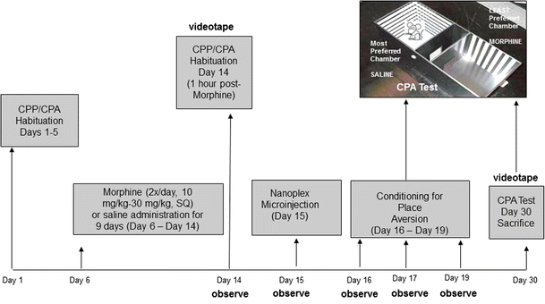
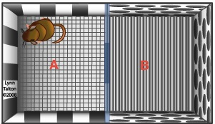
Fig 1
Most preferred
chamber- Saline
Least preferred chamber- Morphine
Conditioned Place Aversion
Notes:
D1- d5- habituation: allowed to explore both sides 10 min/day to determine side preference. D6-14- veh or morphine to elicit dependence and mimic opiate abuse. D14- 1 hr after morphine inj, another habituation session. Allowed to roam free for 10 min. Most time spent was marked as preferred side. D15 intracerebral nanoplex infusion. Days 16-19, conditioning for place aversion. Confined to preferred side (determined on d14) for 10 min a day. Testing on day 20 and day 30, allowed to roam freely, time spent on each side was measured. Observed signs of withdrawal separately.

Slide 18
Observed signs of withdrawal
Teeth chattering
Rearing
Stretching
Penis licking
Head shakes (eliminated)
Diarrhea
Notes:
On days 15,17,19- Counted symptoms every 2 min for 10 min intervals. Observed signs given a “1”. No signs were scored with a “0” Max score was 20, head shakes were eliminated due to head staples. Diarrhea was automatically given a “1” for the 10 min period.

Slide 19
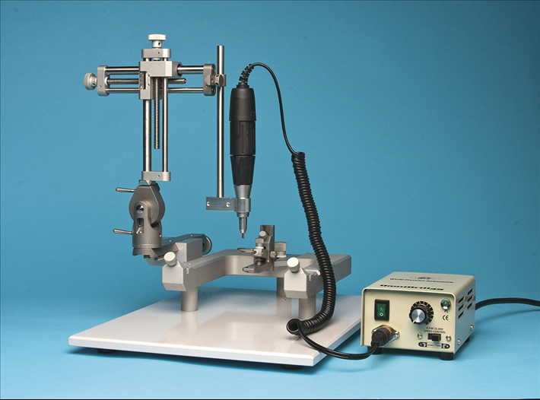
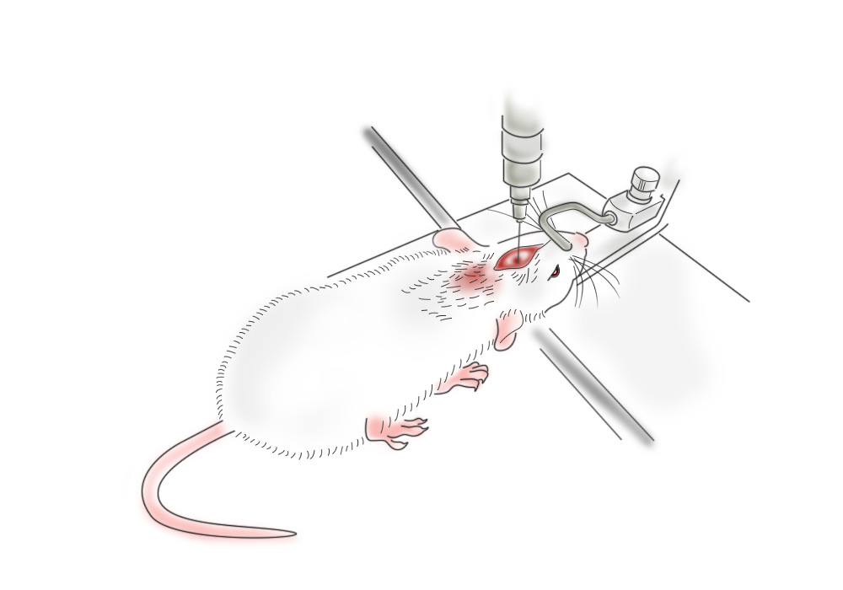
Microinfusion of nanoplex
Anesthetized with 75 mg/kg ketamine and 10 mg/kg xylazine i.p. and secured on a stereotax.
Coordinates targeting the dorsolateral periaqueductal gray (DL-PAG) were set and a hole was drilled through the skull.
A 30G stainless steel needle injected 3μl of the siRNA nanoplex at a rate of 0.5μl/min.
The needle was held in place for an additional 3 min after the injection to allow diffusion.

Slide 20
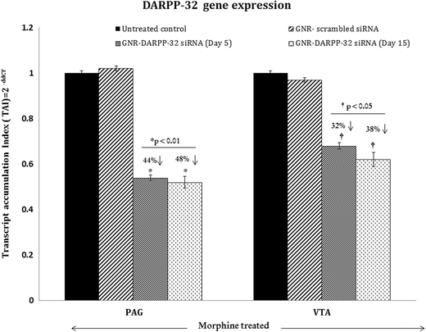
Fig 4
Notes:
Fig. 4 shows DARPP-32 gene expression levels in both PAG and VTA regions on days 5 and 15 post DL-PAG injection in animals administered morphine. We observed approximately 44 % suppression (p<0.01) of DARPP-32 gene expression in brain tissue from the PAG region at 120 h (5 days) post-DL-PAG injection (n=5), and sustained knockdown i.e., 48 % suppression (p<0.01) of DARPP-32 gene expression (n=5) on day 15 post-DL-PAG injection when compared to the untreated controls (no siRNA and no nanoparticle) or to rats that received the control scrambledsiRNA nanoplexes. In brain tissue from the VTA region,
we observed a 32 % suppression (p<0.05) of DARPP-32 gene expression at 5 days (n=7), and a 38 % suppression (p<0.05) (n=7) on day 15 post-DLPAG
injection, as compared to untreated controls or to rats that received scrambled siRNA nanoplexes (Fig. 4).
No significant differences in DARPP-32 gene expression levels were observed between untreated controls and the control scrambled siRNA nanoplexes treated rats. Statistical analysis was done using an average of the day 5 and day 15 gene expression values obtained for the untreated controls and/or the control scrambled siRNA nanoplexes treated rats.

Slide 21
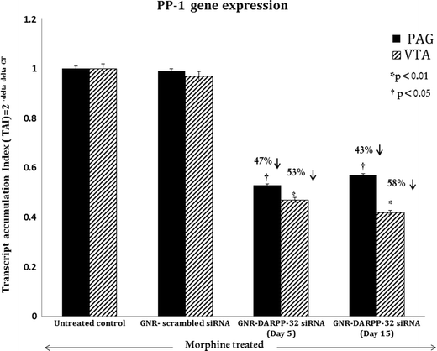
Fig 5
Notes:
We examined the gene expression levels of secondary mediators PP-1 and CREB both in the PAG and VTA regions of the rat brain at 5 and 15 days post administration of the GNR-DARPP-32 siRNA nanoplex into the DL-PAG region in the morphine addicted animals. Figure 5 shows PP-1 gene expression levels in both PAG and VTA regions at 5 and15 days post DL-PAG injection. We observed a 47% suppression (p<0.01) of PP-1 gene expression in brain tissue from the
PAGregion on day 5 (n=7), and a 43%suppression (p<0.05) (n=7) on day 15 post-DL-PAG injection, as compared to the untreated controls. In the VTA brain tissue, we observed a 53 % suppression (p<0.01) on day 5 (n=7), and a 58 % suppression (p<0.01) (n=7) on day 15 post-DL-PAG injection, as compared to untreated controls.

Slide 22
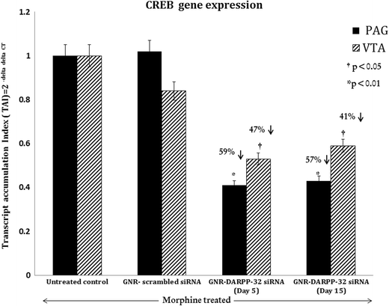
Fig 6
Notes:
Figure 6 shows CREB gene expression levels in both PAG and VTA regions at 5 and 15 days post DL-PAG injection. We observed a 59% suppression (p<0.001) of CREB gene expression in brain tissue from the PAG region on day 5 (n=7), and a 57 % suppression (p<0.01) (n=7) on day 15 post-DL-PAG injection, as compared to the untreated controls. In the VTA brain tissue, we observed a 47 % suppression (p<0.01) on day 5 (n=7), and a 41 % suppression (p<0.01) (n=7) on day 15 post-DL-PAG injection, as compared to untreated controls. No significant differences in PP-1 and CREB gene expression levels were observed between untreated controls and the control scrambled siRNA nanoplexes treated rats. Statistical analysis was done using an average of the day 5 and day 15 gene expression values obtained for the untreated controls and/or the control scrambled siRNA nanoplexes treated rats.

Slide 23
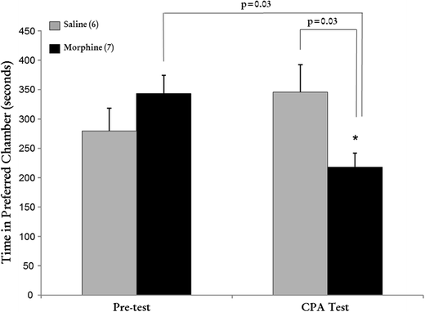
Fig 9
Notes:
Figure 9 shows that the preference score of saline rats was not significantly different between the pre- and CPA tests. Cessation of MS administration induced withdrawal as observed by development of CPA. Rats that experienced morphine withdrawal spent significantly less time in their “preferred” chamber following extinction of the withdrawal symptoms as compared to saline administered rats (218±24 s vs 343±31 s, respectively, p=0.03).

Slide 24
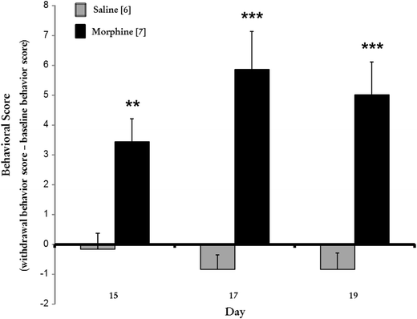
Fig 10
Notes:
Figure 10 shows the difference scores of physical signs of withdrawal in saline (n=6) vs morphine (n=7) rats on days 15, 17 and 19. Morphine addicted rats showed significant withdrawal signs as compared to the saline group on each day.

Slide 25
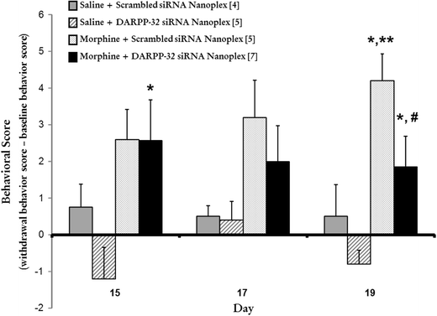
Fig 11
Notes:
Figure 11 shows the total averaged scores of physical signs of withdrawal in the animals with the microinjection of the nanoplexes into the DL-PAG region. Significant withdrawal signs in the morphine + scrambled siRNA and morphine + DARPP-32 siRNA nanoplex treated animals as compared to their respective saline treated counterparts.

Slide 26
Fig 12
Notes:
Figure 12 shows the microinjection of the DARPP-32 nanoplex into morphine addicted rats approached a difference score similar to saline control groups.

Slide 27

Discussion/ Conclusions
GNR-siRNA nanoplexes readily cross the BBB in vitro
There are no apparent adverse side effects
GNR-siRNA silences DARPP-32 gene expression, thereby significantly reducing the negative cascade
DARPP-32 is a potential therapy for drug addiction

Slide 28
Questions/ Future Studies
If GNR-siRNA readily crosses the BBB in vitro, are there reasons can’t it be given systemically?

